Slide 1
HEALTHCARE DATA ANALYSIS
Patients Healthcare Analytics
A comprehensive review of patient volume, medical conditions, billing performance, and hospital operations
Prepared by
Subhodip Sarkar
Data Analyst

Slide 2
Executive Summary
Key performance indicators across the full patient dataset
54.97K
₹1.4bn
₹25.55K
52 yrs
15 days
Total Patients
Billing Amount
Avg Bill
Avg Age
Avg Stay
54,966 records
Total revenue
Per patient
Range 49-53
Per admission
Top 3 Medical Conditions
Total Cancer Patients
Arthritis
9.2K
9,140
Diabetes
9.2K
Gender split — Male 27,496 | Female 27,470
Hypertension
9.1K
Patients Healthcare Analytics
2

Slide 3
Patient Demographics
Distribution of patients by medical condition and gender
Patients by Medical Condition
Gender Split
27,496
27,470
Male Patients
Female Patients
Nearly balanced split — only 26 patients apart
Patients Healthcare Analytics
3

Slide 4
Financial Performance
Billing amount trends by year and by insurance provider
Billing Amount by Year (₹ bn)
Billing Amount by Insurance Provider
Patients Healthcare Analytics
4

Slide 5
Admissions & Care Team
Admission type breakdown and the leading doctors by patient volume
Admission Type
Top 7 Doctors by Patient Volume
1
M. Smith
2
J. Smith
3
R. Smith
4
M. Johnson
5
Ja. Smith
6
D. Smith
Elective 18.47K (33.6%) • Urgent 18.39K (33.5%) • Emergency 18.1K (32.9%)
7
Ro. Johnson
Patients Healthcare Analytics
5

Slide 6
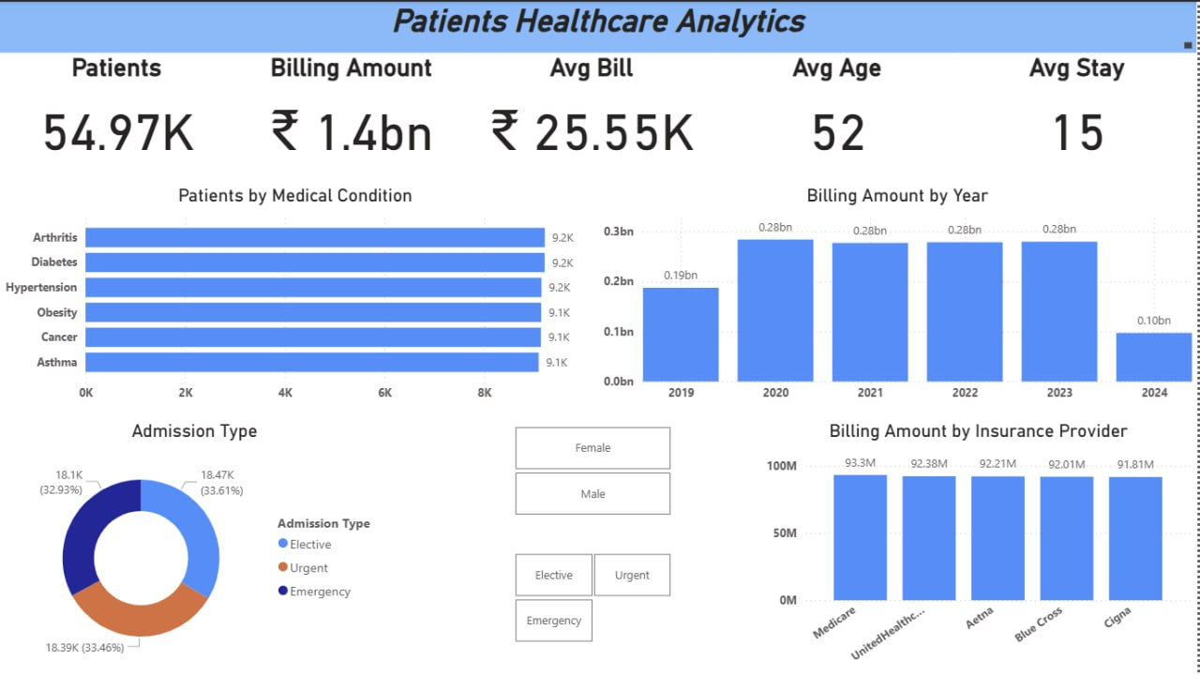
Dashboard Snapshot
Power BI – Patients Healthcare Analytics dashboard
Patients Healthcare Analytics
6

Slide 7
Key Insights
Patient base is large and evenly split — 54,966 total patients, nearly 50/50 across gender.
Arthritis, diabetes, and hypertension are the leading conditions, each affecting roughly 9.1–9.2K patients.
Admission types are well balanced across elective, urgent, and emergency cases (~33% each).
Billing peaked between 2020–2023 at ₹0.28bn per year, with 2024 data only partially captured.
Top 5 insurance providers each contribute ₹90M+ in billing, led narrowly by Medicare.
Thank you
Subhodip Sarkar • Data Analyst
Patients Healthcare Analytics
7

